Slide 1


Slide 2

Team Intro
Training Overview
Training Objectives
Training Prerequisites
System Requirements
Course Duration
What is DevOps and Cloud
Why AWS
Q&A
Certification ?

Slide 3
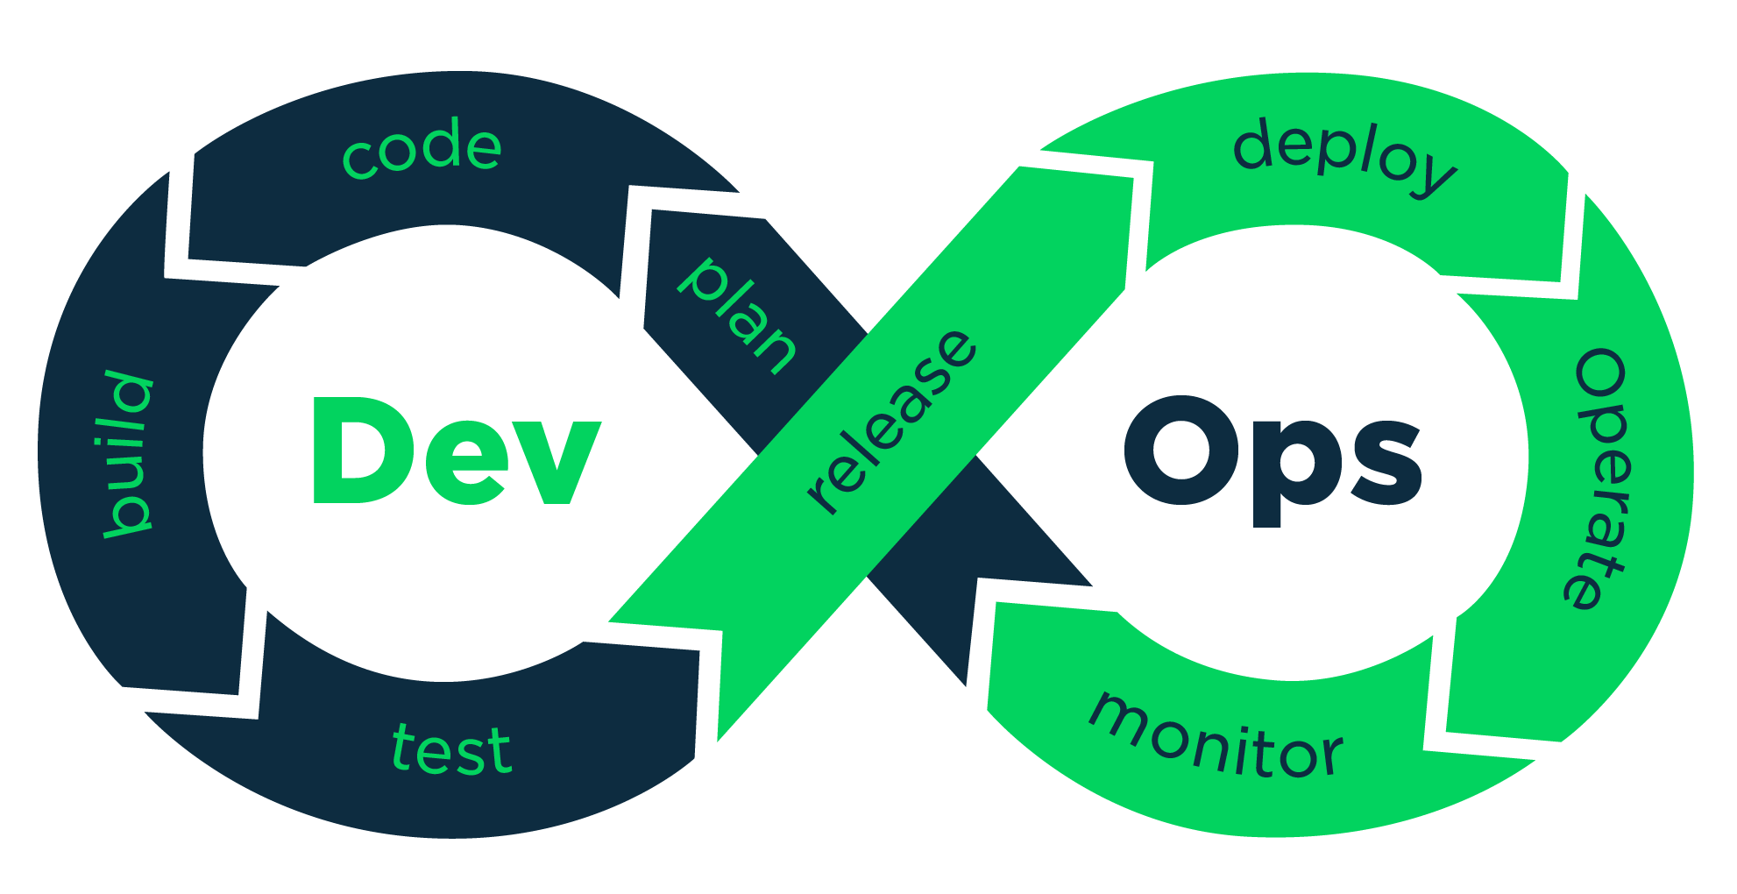

Slide 4
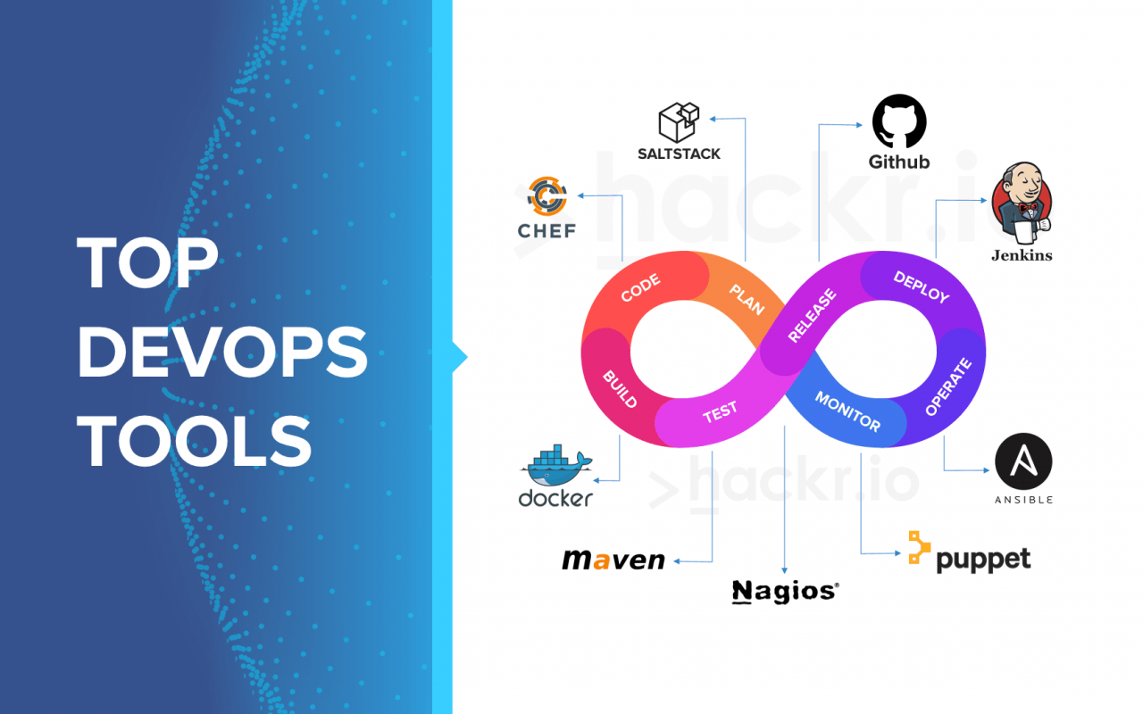
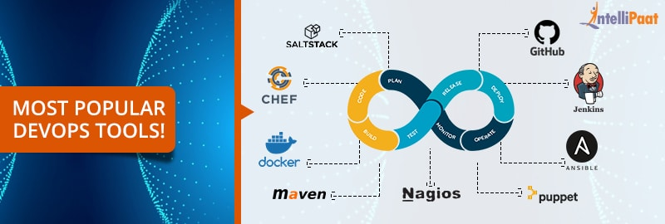

Slide 5
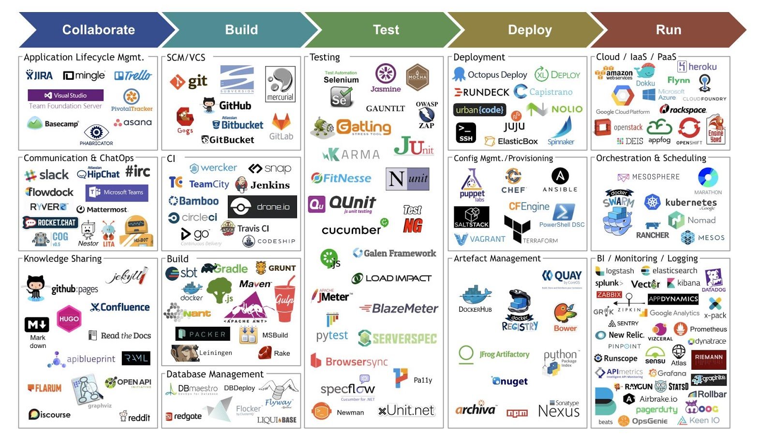

Slide 6


Introduction to DevOps
DevOps Adoption
Source Code Management – GITHUB
JENKINS
ANSIBLE
Vagrant
CHEF
PUPPET
MONITORING
APPLICATION ARCHITECTURE
CONFIGURATION MANAGEMENT

Slide 7
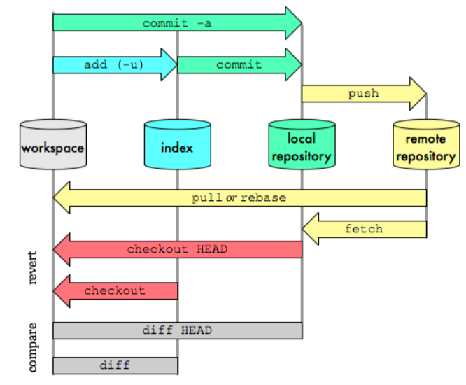

Slide 8
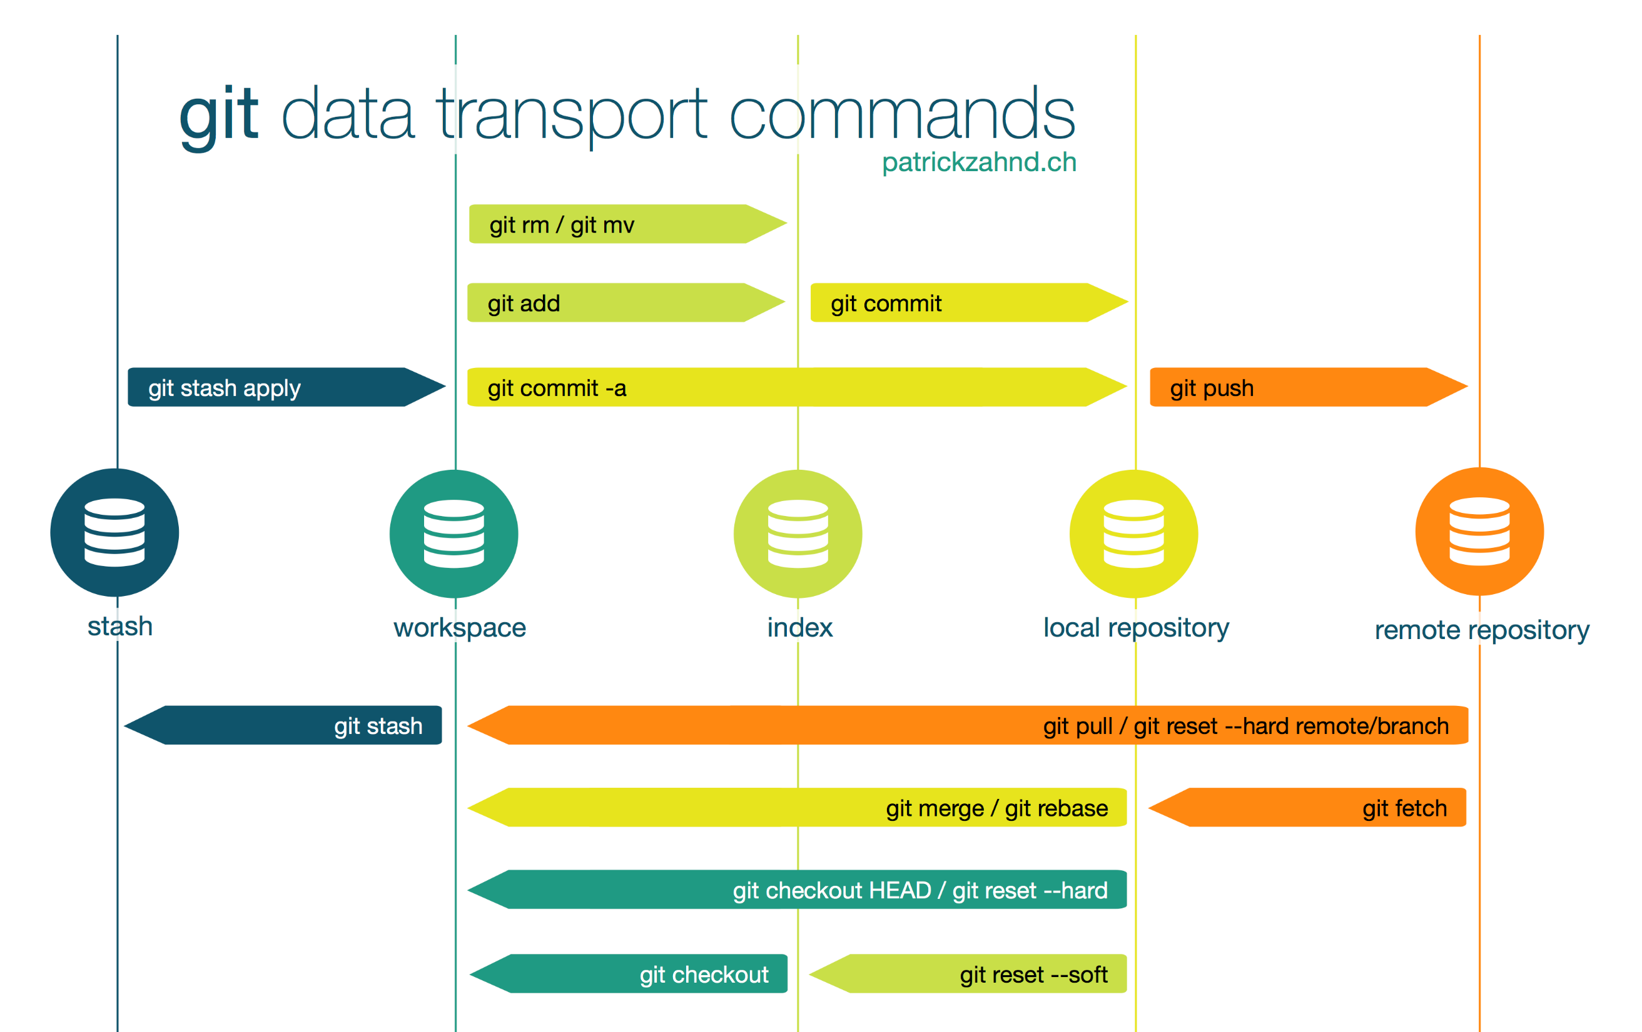

Slide 9
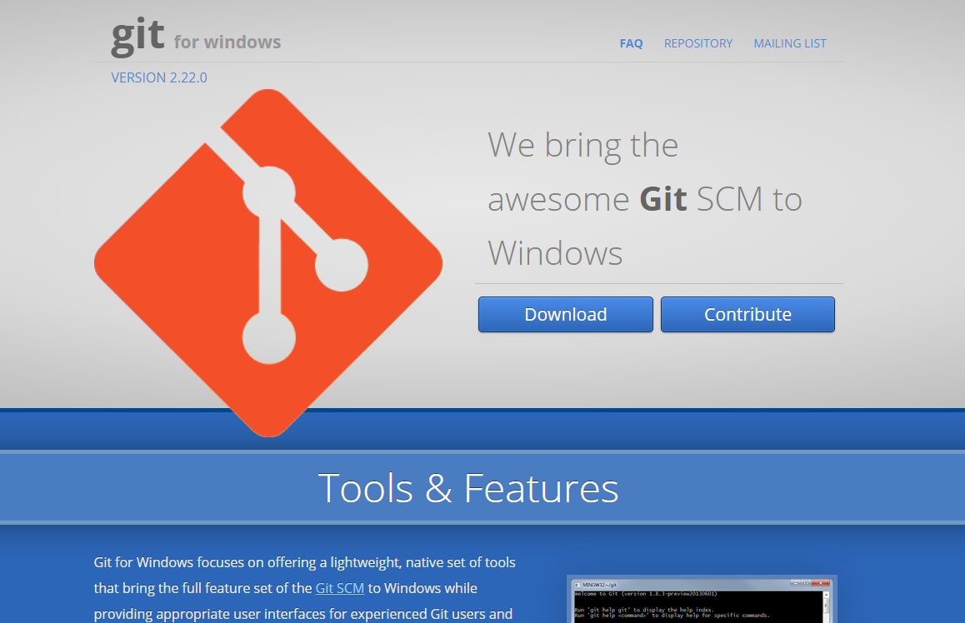
https://gitforwindows.org/

Slide 10
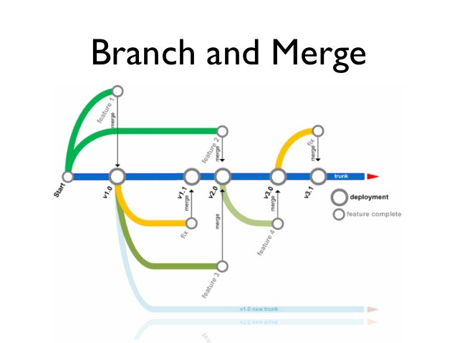

Slide 11
# There are 3 levels of git config; project, global and system.
# project: Project configs are only available for the current project and stored in .git/config in the project's directory.
# global: Global configs are available for all projects for the current user and stored in ~/.gitconfig.
# system: System configs are available for all the users/projects and stored in /etc/gitconfig.
# Create a project specific config, you have to execute this under the project's directory.
$ git config user.name "John Doe"
# Create a global config
$ git config --global user.name "John Doe"
# Create a system config
$ git config --system user.name "John Doe"

Slide 12
git pull https://github.com/UNoorul/DevOps master
git status
git push --set-upstream https://github.com/UNoorul/DevOps master
git push <REMOTENAME> <BRANCHNAME>

Slide 13
git remote
git remote –v
git remote add pb https://github.com/UNoorul/DevOps
git remote rename prog1 payroll
git remote
git remote remove payroll
git remote
git log --oneline
git branch feature2
git checkout <>
git reset <> hard soft(index area) mixed*(workspace)

Slide 14
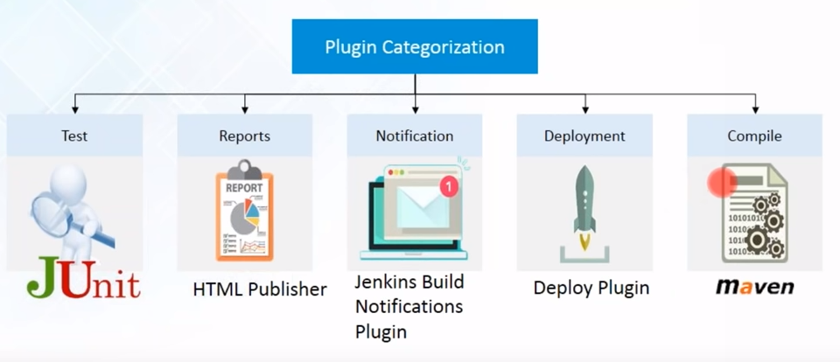

Slide 15

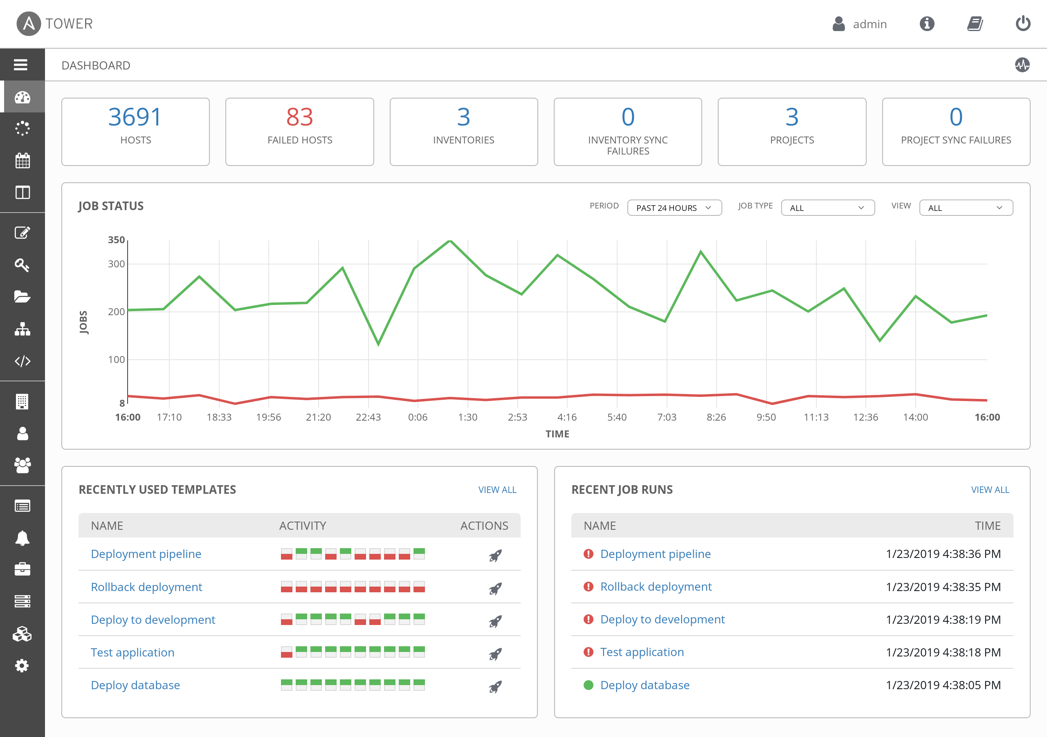
Tower

Slide 16
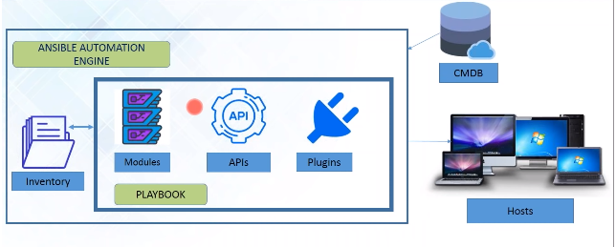
Architecture
Ansible is a Configuration Management, Deployment and Orchestration tool.
It is a push-based configuration management tool.
It automates your entire IT infrastructure by providing large productivity gains.

Slide 17
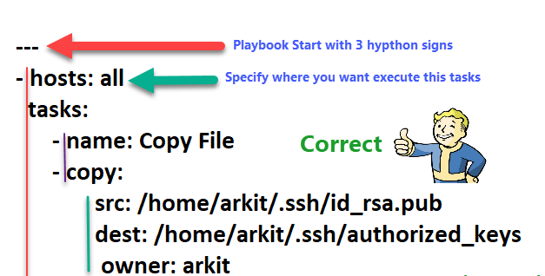
Playbooks
Hosts
Variables
Tasks
Handlers

Slide 18
Playbooks
---
- hosts: webservers
tasks:
- name: install apache2
apt: name=apache2 update_cache=yes state=latest
notify
- restart apache2
handlers:
- name: restart apache2
service: name=apache2 state=restarted
Hosts
Variables
Tasks
Handlers

Slide 19
Can be used for..
Application Deployment
Orchestration
Configuration Management
Provisioning
Security & Compliance

Slide 20
Week 1
Week 2
Week 3
Week 4

